Slide 1



A Communication-centric Approach for Designing Flexible Accelerators
STONNE Tutorial
José L. Abellán
Ramón y Cajal Researcher
Dpto. Ingeniería y Tecnología de Computadores
University of Murcia
Tutorial at ASPLOS
March 26, 2023
Email: jlabellan@um.es

Slide 2
Agenda
Time (PT) | Topic | Presenter
1:40 – 2:00 | Flexible Accelerators | José L. Abellán
2:00 – 2:20 | Cycle accurate simulation and Overview of STONNE | José L. Abellán
2:20 – 3:20 | (Hands-on) STONNE | Francisco Muñoz-Martínez
3:20 – 3:40 | Coffee Break
3:40 – 4:10 | (Hands-on) SST-STONNE | Francisco Muñoz-Martínez
4:10 – 4:40 | (Hands-on) OMEGA | Raveesh Garg
4:40 – 5:00 | Roadmap and Concluding Remarks | Tushar Krishna
https://stonne-simulator.github.io/ASPLOSTUT.html

Slide 3
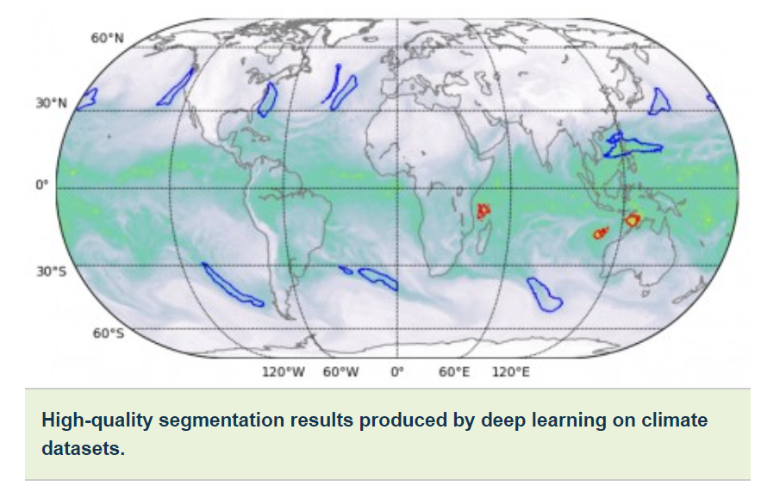
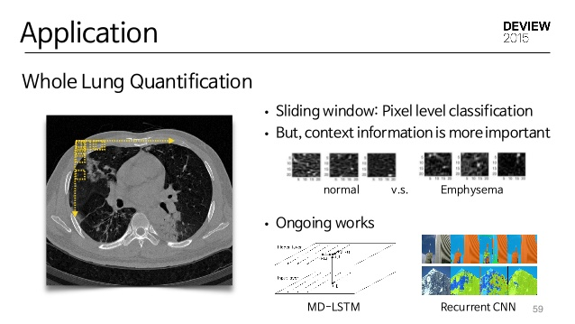


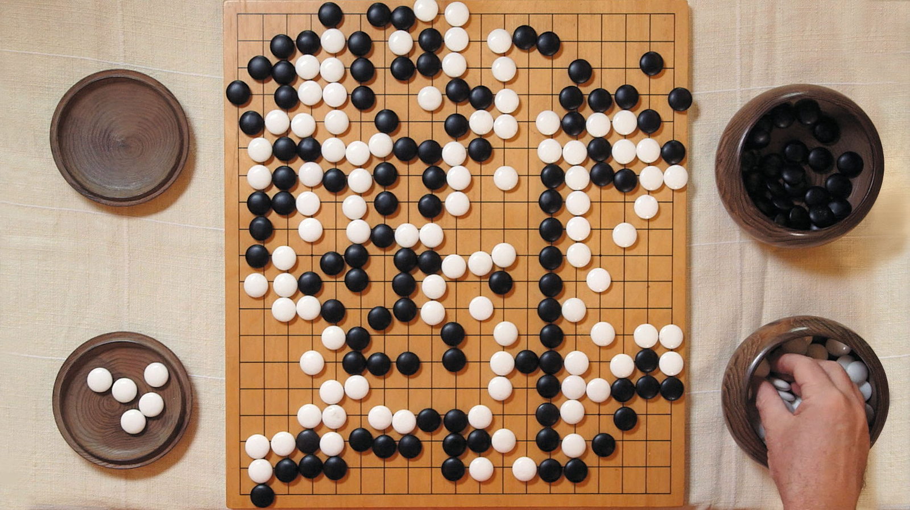
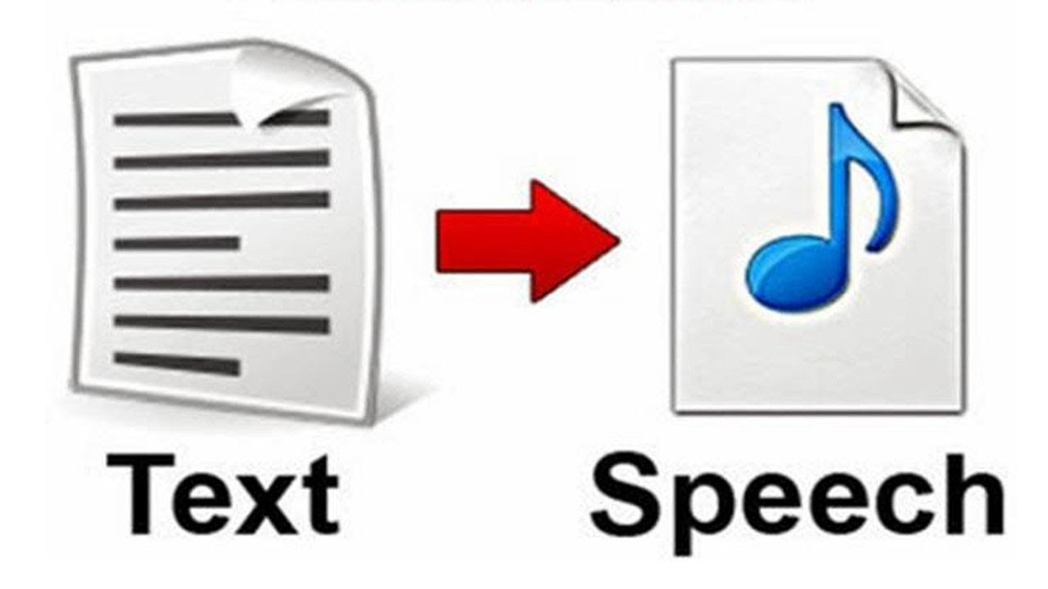
Deep Learning Applications
Object Detection
Image Segmentation
Medical Imaging
Speech Recognition
Text to Speech
Recommendations
Games
Notes:
Thanks for DL, we have made massive strides in that direction. DL has shown tremendous potential across a suite of application areas..

Slide 4
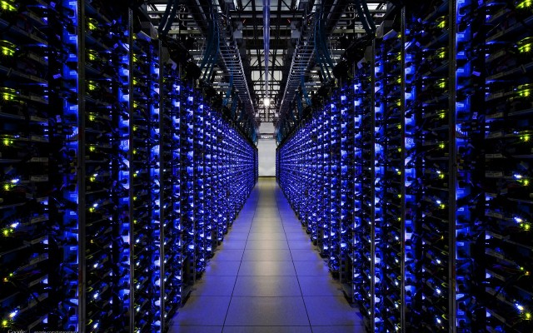


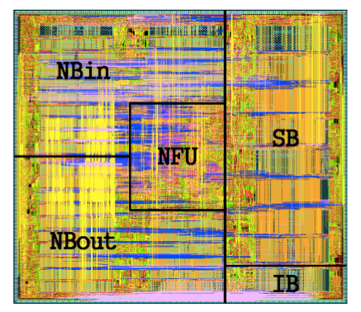

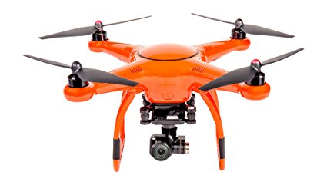
Computation Platforms for Deep Learning
Training
Inference
ARM Trillum
NVDLA
Apple Neural Engine
CambriconX
ShiDianNao
Eyeriss
Inference Accelerators
CPU / GPU / TPU clusters

Slide 5
Outline
DNN Accelerators
Benefits of Mapping Flexibility
Communication-centric Accelerators
Case Study
Conclusion

Slide 6
Why do we need DNN accelerators?
Millions of Parameters (i.e., weights)
Billions of computations
Heavy data movement
Need lots of parallel compute
DNN Topology | Number of Weights
AlexNet (2012) | 3.98M
VGGnet-16 (2014) | 28.25M
GoogleNet (2015) | 6.77M
Resnet-50 (2016) | 23M
DLRM (2019) | 540M
Megatron (2019) | 8.3B
This makes CPUs inefficient
Need to reduce energy
This makes GPUs inefficient

Slide 7
Spatial (or Dataflow) Accelerators
Millions of Parameters (i.e., weights)
Billions of computations
Heavy data movement
Memory Hierarchy
Spread computations across hundreds of ALUs
ALU
ALU
ALU
ALU
Control
Register/FIFO/SRAM
ALU
ALU
ALU
ALU
Memory Hierarchy
ALU
ALU
ALU
ALU
Reuse data within the array via local storage and direct communication
ALU
ALU
ALU
ALU
Examples: MIT Eyeriss, Google TPU, Xilinx xDNN

Slide 8
Types of Algorithmic Data Reuse in DNNs
Convolutional Reuse
Fmap Reuse
Filter Reuse
CONV layers only
(sliding window)
CONV and FC layers
CONV and FC layers
(batch size > 1)
Input Fmaps
Filters
Input Fmap
Input Fmap
Filter
Filter
1
1
2
2
Activations
Filter weights
Reuse:
Reuse:
Activations
Reuse:
Filter weights
Slide Acknowledgment: Yu-Hsin Chen, Vivenne Sze, Joel Emer (MIT)
Notes:
The third type of reuse is filter reuse, which also exists in both CONV and FC layer when batch size is larger than 1. When multiple fmap exists, they are streamed through the processor with the same filter, and therefore the same filter weights are reused across many fmaps.

Slide 9
Mapping and Dataflow
7-dimensional network layer
C
Weights
Inputs
Outputs
PE
PE
PE
PE
K
Number of PEs
Memory Hierarchy
Interconnect Bandwidth
…
R
map
PE
PE
PE
PE
Y
Y’
K
C
S
C
PE
PE
PE
PE
X
X’
.
.
.
.
.
.
PE
PE
PE
PE
N
N
7D Computation Space: R * S * X * Y * C * K * N
Precise Definition of Mapping: Fine-grained schedule of computations within DNN accelerators
Computation Order (slowest tensor dimension often called “stationary”)
Parallelization Strategy (which loops to unroll spatially)
Tiling Strategy (number of levels of memory hierarchy)
Tile Sizes
Note: Implication of mapping/dataflow: translate algorithmic data reuse to HW data reuse
Dataflow

Slide 10
Mapping and Dataflow
7-dimensional network layer
C
Weights
Inputs
Outputs
PE
PE
PE
PE
K
Number of PEs
Memory Hierarchy
Interconnect Bandwidth
…
R
map
PE
PE
PE
PE
Y
Y’
K
C
S
C
PE
PE
PE
PE
X
X’
.
.
.
.
.
.
PE
PE
PE
PE
N
N
7D Computation Space: R * S * X * Y * C * K * N
Precise Definition of Mapping: Fine-grained schedule of computations within DNN accelerators
Computation Order (slowest tensor dimension often called “stationary”)
Parallelization Strategy (which loops to unroll spatially)
Tiling Strategy (number of levels of memory hierarchy)
Tile Sizes
Note: Implication of mapping/dataflow: translate algorithmic data reuse to HW data reuse
Dataflow

Slide 11
Hardware Structures to Exploit Reuse
Temporal Reuse
Spatial Reuse
Spatio-Temporal Reuse
PEs
PEs
PEs
PE0
PE1
PE2
PE3
…
PE0
PE1
PE2
PE3
…
PE0
PE1
PE2
PE3
…
…
1
…
…
1
1
…
0
1
…
PE0
PE1
PE2
PE3
…
PE0
PE1
PE2
PE3
…
PE0
PE1
PE2
PE3
…
Time
…
1
…
Time
…
2
2
…
Time
…
0
1
…
DRAM
Buf
ALU
Buf
RF
Buf
Memory Hierarchy / Staging Buffers
Multicasting-support NoCs
Neighbor-to-Neighbor Connections
E.g., Custom memory hierarchies in accelerators.
E.g., Hierarchical Bus in Eyeriss (ISCA 2016), Tree in MAERI (ASPLOS 2018)
E.g., TPU (ISCA 2017), local network in Eyeriss (ISCA 2016)
The Accelerator’s “Dataflow” determines which structures are needed and their size

Slide 12
Outline
DNN Accelerators
Benefits of Mapping Flexibility
Communication-centric Accelerators
Case Study
Conclusion

Slide 13



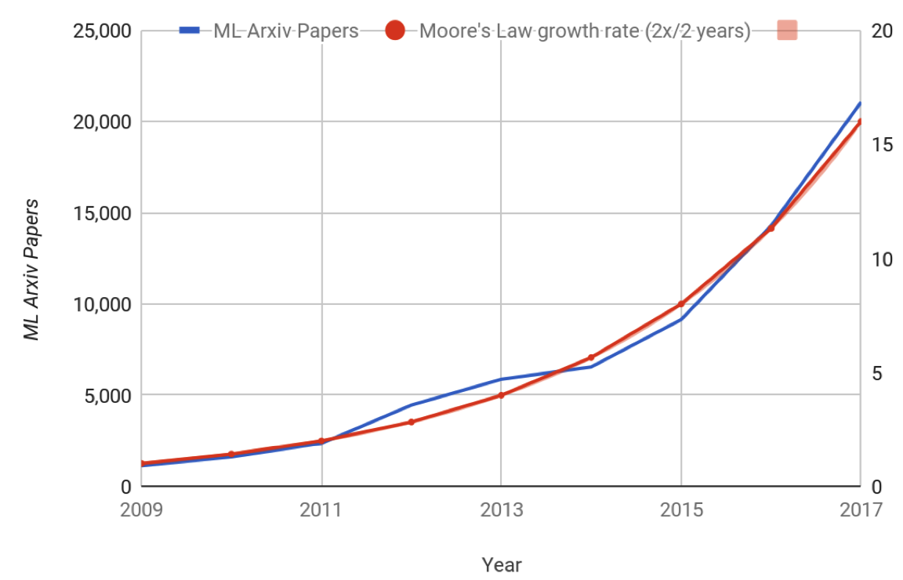
Why do we need flexible DNN accelerators?
Trend 1: Diversity in DNN Models
Layer Sizes
Layer Shapes
Layer Types
…
Image Processing
Speech Recognition
<Number of new ML papers in Arxiv>
Translation
Evolution of DNN Applications
MobileNetv2
AlexNet
VGGNet
ResNet
Transformer
EfficientNet
2012
2014
2015
2016
2017
2018
2019
Evolution of DNN Models

Slide 14
Why do we need flexible DNN accelerators?
Trend 1: Diversity in DNN Models
Layer Sizes
Layer Shapes
Layer Types
Trend 2: Diversity in Implementations
Depth-wise/Point-wise Convolutions
Pruning → Sparsity
e.g. of Depth-wise Separable CONV
e.g. of Pruning

Slide 15
Why do we need flexible DNN accelerators?
Trend 1: Diversity in DNN Models
Layer Sizes
Layer Shapes
Layer Types
Trend 2: Diversity in Implementations
Depth-wise/Point-wise Convolutions
Pruning → Sparsity
Trend 3: Diversity in Mapping/Dataflow
Loop Transformations (“Dataflow”)
Order, Parallelization, Tiling
“Weight Stationary”, “Row Stationary”
Partitioning Strategies – Per Layer, Cross Layer, ..
C
Weights
Inputs
Outputs
K
R
Y
Y’
K
C
S
C
X
X’
.
.
.
.
.
.
N
N
map
Computation Order
Parallelization
Tiling
Dataflow
PE
PE
PE
PE
Data Reuse
PE
PE
PE
PE
PE
PE
PE
PE
Data Movement
PE
PE
PE
PE

Slide 16
Why do we need flexible DNN accelerators?
Trend 1: Diversity in DNN Models
Layer Sizes
Layer Shapes
Layer Types
Trend 2: Diversity in Implementations
Depth-wise/Point-wise Convolutions
Pruning → Sparsity
Trend 3: Diversity in Mapping/Dataflow
Loop Transformations (“Dataflow”)
Order, Parallelization, Tiling
“Weight Stationary”, “Row Stationary”
Partitioning Strategies – Per Layer, Cross Layer, ..
Myriad “irregular” shapes, sizes, accesses
Challenge:
Getting high-utilization from accelerator for all cases.
Why?
Aren’t DNNs essentially Matrix-Matrix multiplications?

Slide 17
Example of GEMM Operation
K
N
N
M
K
M
Metric 1: Mapping Efficiency
Percentage of PEs with useful computations mapped over them
Metric 2: Utilization
Mapping Efficiency x Activity
e.g., TPU

Slide 18
Mapping Examples
Communication
Distribute
Reduce/Collect
Regular
4
8
4
4
Physical Array: 4x4
Map Effic. = 100%
Distribute
Row multicast
Collect
Column Reduce

Slide 19
Mapping Examples
Communication
Distribute
Reduce/Collect
Regular
Irregular
Irregular
Sparse
4
8
2
8
5
8
4
8
2
3
5
4
8
6
4
4
Physical Array: 4x4
Map Effic. = 100%
Map Effic. = 50%
Map Effic. = 75%
Map Efffic. = 62%
Distribute
Row multicast
Collect
Column Reduce
Map Effic. = 50%
Map Effic. = 19%
Map Effic. = 38%

Slide 20
Mapping Efficiency needs Mapping Flexibility
Regular
Irregular
Irregular
Sparse
4
8
2
8
5
8
4
8
2
3
5
4
8
6
4
4
Logical: 2x8
Logical: 5x3
Logical: {3x1, 2x1, 4x1, 1x1, 4x1, 2x1}
Physical Array: 4x4
Map Effic. = 100%
Map Effic. = 100%
Map Effic. = 100%
Map Effic. = 94%
How to support Mapping Flexibility?
Distribute
Row multicast
Spatial Multicast
Multicast to non-neighbors
Only send non-zeros
Collect
Column Reduce
Multiple Parallel
Variable Length
Variable Non-Uniform Length
Flexible data distribution and reduction

Slide 21
Levels of Flexibility
Regular
Irregular
Irregular
Sparse
4
8
2
8
5
8
4
8
2
3
5
4
8
6
4
4
Logical: 2x8
Logical: 5x3
Logical: {3x1, 2x1, 4x1, 1x1, 4x1, 2x1}
Physical Array: 4x4
Map Effic. = 100%
Map Effic. = 100%
“Cluster”
Map Effic. = 100%
Map Effic. = 94%
Fixed Homogeneous Clusters
(i.e., fixed cluster size
=> fixed aspect ratio)
Partially-Flexible
Homogeneous Clusters
(configurable (limited choices) number of PEs per cluster)
Fully-Flexible
Homogeneous Clusters
(configurable (any choice) number of PEs per cluster)
Fully-Flexible Heterogeneous Clusters
(configurable (any choice) unequal sized clusters)

Slide 22
Summary of Mapping Challenge
Irregular and Sparse GEMMs introduce under-utilization
Desired Features for 100% Utilization
Distribution
Variable Sized Multicast
Multiple in Parallel
[For Sparsity: Only send non-zero weights/activations]
Collection
Variable Sized Reduction
Multiple in Parallel

Slide 23
Outline
DNN Accelerators
Benefits of Mapping Flexibility
Communication-centric Accelerators
Case Study
Conclusion

Slide 24
Communication-centric Accelerator Design
A
B
C
D
I
J
K
L
4x4 Rigid Array
Fixed Homogeneous Clusters

Slide 25
Communication-centric Accelerator Design
Functionality:
Distribute weight and input operands to any PE
(pattern depends on Mapping)
Optimizations:
- Bandwidth amplification via in-network multicast
- Local forwarding links
Implementation:
Topology: Bus/Store-and-Fwd/Tree/..
Latency: O(1) to O(N)
No-stall Bandwidth: O(sqrt(N)-O(N)
Distribution Network
Functionality:
Collection final (or partial) outputs from the PEs
(pattern depends on Mapping)
Optimizations:
- Bandwidth reduction via in-network reduction
Implementation:
Area: Bus/Reduce-and-Fwd/Tree/…
Latency: O(1)/O(log(N))/O(sqrt(N)
No-stall Bandwidth: O(sqrt(N)-O(N)
A
B
C
D
I
J
K
L
E
F
G
H
M
N
O
P
Reduction Network
4x4 Flexible Array
Part-Flexible Homogenous Clusters
Full-Flexible Homogenous Clusters
Full-Flexible Hetero. Clusters

Slide 26
Comm-centric Classification of DNN Accelerators
Accelerator | Distribution Network Latency, Injection BW | Reduction Network Latency, Ejection BW | Level of Flexibility
Eyeriss (ISSCC 2016) | (multiple) Bus O(1), param | Bus O(1), 1 | Partially-Flexible Homogeneous Clusters
TPU (ISCA 2017) | Store-and-Fwd O(sqrtN), sqrt(N) | Reduce-and-Fwd O(sqrt(N), sqrt(N) | Fixed Homogeneous Clusters
NVDLA (2017) | Bus O(1), 1 | Tree O(logN), 1 | Fixed Homogeneous Clusters
MAERI (ASPLOS 2018) | Chubby-Tree O(1), param | Augmented Reduction Tree (ART) O(logN), param | Fully-Flexible Homogeneous Clusters
Eyeriss_v2 (JETCAS 2019) | Hierarchical Mesh O(sqrt(N)), param | Hierarchical Mesh O(sqrt(N)), param | Fully-Flexible Homogeneous Clusters (with Sparsity Controller)
SIGMA (HPCA 2020) | Benes O(1), N | Forwarding Adder Network (FAN) O(log(N)), N/2 | Fully-Flexible Heterogeneous Clusters (with Sparsity Controller)

Slide 27
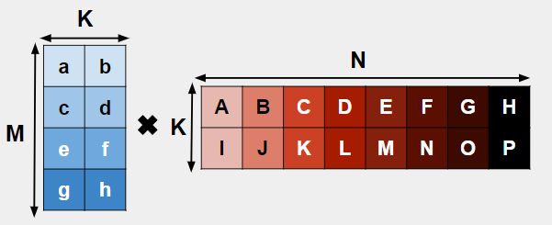
Example - Irregular GEMMs on SIGMA
** Assuming MK matrix is streaming and KN matrix is stationary. (aka weight stationary)
Set up the stationary values.
g
e
c
a
A
B
C
D
h
f
d
b
I
J
K
L
4 x 4 Systolic Array

Slide 28
Example - Irregular GEMMs on SIGMA
** Assuming MK matrix is streaming and KN matrix is stationary. (aka weight stationary)
Set up the stationary values.
Distribution Network
g
e
c
a
A
B
C
D
g
e
c
a
A
B
C
D
h
f
d
b
I
J
K
L
h
f
d
b
I
J
K
L
E
F
G
H
M
N
O
P
Reduction Network
4 x 4 Systolic Array
16 PE SIGMA

Slide 29
Example - Irregular GEMMs on SIGMA
** Assuming MK matrix is streaming and KN matrix is stationary. (aka weight stationary)
Next cycle: Multicast first row of MK to the corresponding stationary elements.
Distribution Network
g
e
c
a
A
B
C
D
A
B
C
D
g
e
c
a
a
a
a
h
f
d
b
I
J
K
L
I
J
K
L
h
f
d
b
b
b
b
a
a
a
a
E
F
G
H
b
b
b
b
M
N
O
P
Reduction Network
4 x 4 Systolic Array
16 PE SIGMA

Slide 30
Example - Irregular GEMMs on SIGMA
** Assuming MK matrix is streaming and KN matrix is stationary. (aka weight stationary)
Next cycle: Multicast second row of MK to the corresponding stationary elements.
Distribution Network
g
e
c
A
B
C
D
A
a
B
C
D
g
e
c
c
c
c
h
f
d
I
J
K
L
I
b
J
K
L
h
f
d
d
d
d
c
c
c
c
E
F
G
H
d
d
d
d
M
N
O
P
Reduction Network
4 x 4 Systolic Array
16 PE SIGMA

Slide 31
Example - Irregular GEMMs on SIGMA
** Assuming MK matrix is streaming and KN matrix is stationary. (aka weight stationary)
Next cycle: Multicast third row of MK to the corresponding stationary elements.
Distribution Network
g
e
A
B
C
D
A
c
B
a
C
D
g
e
e
e
e
h
f
I
J
K
L
I
d
J
b
K
L
h
f
f
f
f
e
e
e
e
E
F
G
H
f
f
f
f
M
N
O
P
Reduction Network
4 x 4 Systolic Array
16 PE SIGMA

Slide 32
Example - Irregular GEMMs on SIGMA
** Assuming MK matrix is streaming and KN matrix is stationary. (aka weight stationary)
Next cycle: Multicast fourth row of MK to the corresponding stationary elements.
Distribution Network
g
A
B
C
D
A
e
B
c
C
a
D
g
g
g
g
h
I
J
K
L
I
f
J
d
K
b
L
h
h
h
h
g
g
g
g
E
F
G
H
h
h
h
h
M
N
O
P
Reduction Network
4 x 4 Systolic Array
16 PE SIGMA

Slide 33
Example - Irregular GEMMs on SIGMA
** Assuming MK matrix is streaming and KN matrix is stationary. (aka weight stationary)
After accumulation, SIGMA is done. However, the systolic array has to map the other side of the stationary matrix and stream in the MK matrix again (referred to as folding).
Distribution Network
g
e
c
a
E
F
G
H
A
B
C
D
g
g
g
g
h
f
d
b
M
N
O
P
I
J
K
L
h
h
h
h
DONE
g
g
g
g
E
F
G
H
h
h
h
h
M
N
O
P
Reduction Network
4 x 4 Systolic Array
16 PE SIGMA

Slide 34
Example - Irregular GEMMs on SIGMA
** Assuming MK matrix is streaming and KN matrix is stationary. (aka weight stationary)
SIGMA reduces the number of folds, which then reduces the number of memory references on the streaming matrix.
After accumulation, SIGMA is done. However, the systolic array has to map the other side of the stationary matrix and stream in the MK matrix again.
Distribution Network
g
e
c
a
E
F
G
H
A
B
C
D
g
g
g
g
h
f
d
b
M
N
O
P
I
J
K
L
h
h
h
h
DONE
g
g
g
g
E
F
G
H
h
h
h
h
M
N
O
P
Reduction Network
4 x 4 Systolic Array
16 PE SIGMA

Slide 35
Example - Irregular GEMMs on SIGMA
** Assuming MK matrix is streaming and KN matrix is stationary. (aka weight stationary)
Final cycle count.
Distribution Network
E
F
G
H
A
B
C
D
M
N
O
P
I
J
K
L
Systolic Array total runtime:
24 cycles
SIGMA total runtime:
13 cycles
E
F
G
H
M
N
O
P
Reduction Network
4 x 4 Systolic Array
16 PE SIGMA

Slide 36
Example - Irregular GEMMs on SIGMA
** Assuming MK matrix is streaming and KN matrix is stationary. (aka weight stationary)
Final cycle count.
Distribution Network
SIGMA maximizes PE utilization with its flexible interconnects for irregular GEMMs.
E
F
G
H
A
B
C
D
M
N
O
P
I
J
K
L
Systolic Array total runtime:
24 cycles
SIGMA total runtime:
13 cycles
E
F
G
H
M
N
O
P
Reduction Network
4 x 4 Systolic Array
16 PE SIGMA

Slide 37
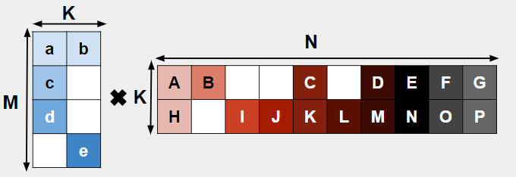
Example - Sparse Irregular GEMMs on SIGMA
** Assuming MK matrix is streaming and KN matrix is stationary. (aka weight stationary)
Set up the stationary values.
g
d
c
a
A
B
C
D
e
f
b
H
I
J
4 x 4 Systolic Array

Slide 38
Example - Sparse Irregular GEMMs on SIGMA
** Assuming MK matrix is streaming and KN matrix is stationary. (aka weight stationary)
Set up the stationary values.
Distribution Network
g
d
c
a
A
B
C
D
g
d
c
a
A
B
J
C
e
f
b
H
I
J
e
f
b
H
I
L
K
D
E
F
G
M
N
O
P
Reduction Network
4 x 4 Systolic Array
16 PE SIGMA

Slide 39
Example - Sparse Irregular GEMMs on SIGMA
** Assuming MK matrix is streaming and KN matrix is stationary. (aka weight stationary)
Next cycle: Multicast first row of MK to the corresponding stationary elements.
Distribution Network
g
d
c
a
A
B
J
C
A
B
C
D
g
d
c
a
a
b
a
e
f
b
f
H
I
L
K
H
I
J
e
b
b
b
b
a
a
a
a
D
E
F
G
b
b
b
b
M
N
O
P
Reduction Network
4 x 4 Systolic Array
16 PE SIGMA

Slide 40
Example - Sparse Irregular GEMMs on SIGMA
** Assuming MK matrix is streaming and KN matrix is stationary. (aka weight stationary)
Next cycle: Multicast second row of MK to the corresponding stationary elements.
Distribution Network
g
d
c
A
B
J
C
A
a
B
C
D
g
d
c
c
c
e
f
H
b
I
J
e
f
H
I
L
K
c
c
c
c
D
E
F
G
M
N
O
P
Reduction Network
4 x 4 Systolic Array
16 PE SIGMA

Slide 41
Example - Sparse Irregular GEMMs on SIGMA
** Assuming MK matrix is streaming and KN matrix is stationary. (aka weight stationary)
Next cycle: Multicast third row of MK to the corresponding stationary elements.
Distribution Network
g
d
A
B
J
C
A
c
B
a
C
D
g
d
d
d
e
f
H
I
L
K
H
b
I
J
e
d
d
d
d
D
E
F
G
M
N
O
P
Reduction Network
4 x 4 Systolic Array
16 PE SIGMA

Slide 42
Example - Sparse Irregular GEMMs on SIGMA
** Assuming MK matrix is streaming and KN matrix is stationary. (aka weight stationary)
Next cycle: Multicast fourth row of MK to the corresponding stationary elements.
Distribution Network
g
A
B
J
C
A
d
B
c
C
a
D
e
f
H
I
L
K
e
e
e
e
e
H
I
b
J
D
E
F
G
e
e
e
e
M
N
O
P
Reduction Network
4 x 4 Systolic Array
16 PE SIGMA

Slide 43
Example - Sparse Irregular GEMMs on SIGMA
** Assuming MK matrix is streaming and KN matrix is stationary. (aka weight stationary)
After accumulation, SIGMA is done. However, the systolic array has to map the other part of the stationary matrix and stream in the MK matrix again (referred to as folding).
Distribution Network
g
d
c
a
C
D
E
A
B
J
C
e
f
H
I
L
K
e
b
K
L
M
N
e
e
e
e
DONE
D
E
F
G
e
e
e
e
M
N
O
P
Reduction Network
4 x 4 Systolic Array
16 PE SIGMA

Slide 44
Example - Sparse Irregular GEMMs on SIGMA
** Assuming MK matrix is streaming and KN matrix is stationary. (aka weight stationary)
Again, the systolic array has to map another part of the stationary matrix and stream MK again.
Distribution Network
g
d
c
a
F
G
A
B
J
C
e
f
H
I
L
K
e
b
O
P
e
e
e
e
DONE
D
E
F
G
e
e
e
e
M
N
O
P
Reduction Network
4 x 4 Systolic Array
16 PE SIGMA
16 PE SIGMA Flex-DPE

Slide 45
Example - Sparse Irregular GEMMs on SIGMA
** Assuming MK matrix is streaming and KN matrix is stationary. (aka weight stationary)
Final cycle count.
Distribution Network
F
G
A
B
J
C
O
P
H
I
L
K
Systolic Array total runtime:
34 cycles
SIGMA total runtime:
13 cycles
D
E
F
G
M
N
O
P
Reduction Network
4 x 4 Systolic Array
16 PE SIGMA
16 PE SIGMA Flex-DPE

Slide 46
Example - Sparse Irregular GEMMs on SIGMA
** Assuming MK matrix is streaming and KN matrix is stationary. (aka weight stationary)
Final cycle count.
SIGMA maps only nonzeros stationary; therefore, reduces the number of folds needed.
Distribution Network
F
G
A
B
J
C
O
P
H
I
L
K
Systolic Array total runtime:
34 cycles
SIGMA total runtime:
13 cycles
D
E
F
G
M
N
O
P
Reduction Network
4 x 4 Systolic Array
16 PE SIGMA
16 PE SIGMA Flex-DPE

Slide 47
Outline
DNN Accelerators
Benefits of Mapping Flexibility
Communication-centric Accelerators
Case Study
MAERI
SIGMA
Conclusion
Hyoukjun Kwon, Ananda Samajdar, and Tushar Krishna
MAERI: Enabling Flexible Dataflow Mapping over DNN Accelerators via Reconfigurable Interconnects:
ASPLOS 2018, IEEE Micro Top Picks 2019 Honorable Mention

Slide 48
The MAERI Abstraction
Multiplier Pool
VN0
VN1
VN2
Adder Pool
Virtual Neuron (VN): Temporary grouping of compute units for an output
Each Virtual Neuron (aka cluster) calculates a dot-product

Slide 49
The MAERI Implementation
Hyoukjun Kwon, Ananda Samajdar, and Tushar Krishna
MAERI: Enabling Flexible Dataflow Mapping over DNN Accelerators via Reconfigurable Interconnects:
ASPLOS 2018, IEEE Micro Top Picks 2019 Honorable Mention

Slide 50
The MAERI Implementation
Distribution (Global) Network
Spatial Reuse via Multicasts
High Bandwidth via fat links

Slide 51
The MAERI Implementation
Local FIFOs for Temporal Reuse i.e. “stationary”

Slide 52
The MAERI Implementation
Distribution (Local) Network
Forwarding of weights or inputs
Spatio-Temporal Reuse

Slide 53
The MAERI Implementation
Collection Network
High Bandwidth via fat links
Provably Non-blocking Reductions via forwarding links

Slide 54
The MAERI Implementation
Distribution (Global) Network
Spatial Reuse via Multicasts
High Bandwidth via fat links
Distribution (Local) Network
Forwarding of weights or inputs
Spatio-Temporal Reuse
Collection Network
High Bandwidth via fat links
Provably Non-blocking Reductions via forwarding links
Local FIFOs for Temporal Reuse i.e. “stationary”

Slide 55
The MAERI Implementation
Distribute Switch (1x2 Switch)
Micro-Switches

Slide 56
Summary of MAERI’s Features
A Communication-Centric Approach to DNN Accelerator Design
Specialized Topology
Tree based distribution
Multiple simultaneous multicasts of variable sizes
Novel tree topology for collection
Multiple simultaneous reductions (dot-products) of variable sizes (i.e., virtual neuron)
Supports all kinds of data reuse (that a mapper can leverage)
Temporal: enabled via local buffers in mult. switches
Spatial (Multicasting): enabled via distribution tree
Spatio-Temporal (St-and-Fwd): enabled via forwarding links between multipliers
Reconfigurable light-weight micro-switches
Exposed to Mapper to support multiple DNNs and Dataflow strategies

Slide 57
Outline
DNN Accelerators
Benefits of Mapping Flexibility
Communication-centric Accelerators
Case Study
MAERI
SIGMA
Conclusion
Eric Qin, Ananda Samajdar, Hyoukjun Kwon, Vineet Nadella,,Dipankar Das, Sudarshan Srinivasan, Bharat Kaul, and Tushar Krishna
SIGMA: Sparse and Irreguler GEMM Accelerator with Flexible Interconnects for DNN Training:
HPCA 2020, Best Paper Award

Slide 58
SIGMA O(1) Distribution Network
Unicast
(Loading Stationary Matrix)
O(1) Distribution
Multicast
(Sending Streaming Matrix)
Crossbar
Crossbar
Benes
Benes
Crossbar
Crossbar
Benes
Benes
Source
Source
Source
Source
X
X
X
X
X
X
X
X
X
X
X
X
X
X
X
X
Destination
Destination
Destination
Destination
SIGMA’s distribution can be either a Crossbar or Benes network. We chose Benes because the number of switches scale by O(N logN).

Slide 59
SIGMA O(logN) Reduction Network
Different clusters of partial sums.
0 1 2 3 4 5 6 7 8 9 10 1 1 12 13 14 15 16 17 18 19 20 21 22 23 24 25 26 27 28 29 30 31
a a a b b b b b b c c c c d d d d d d d d d d d e e e e e e e e
x
x
x
x
x
x
x
x
x
x
x
x
x
x
x
x
x
x
x
x
x
x
x
x
x
x
x
x
x
x
x
x
0
+
2
+
4
+
6
+
8
+
10
+
12
14
16
18
20
22
24
26
28
30
+
+
+
+
+
+
+
+
+
+
1
+
5
+
9
+
13
+
17
21
25
29
+
+
+
+
3
+
11
19
27
+
+
+
7
+
23
+
Forwarding Adder Network (FAN)
N-to-2 Mux
2-input BF16 Mult Switch
2-input BF32 Adder Switch
Forwarding FF
15
x
+
+
Guarantees non-blocking reductions of arbitrary sizes

Slide 60
Outline
DNN Accelerators
Benefits of Mapping Flexibility
Communication-centric Accelerators
Case Study
Conclusion

Slide 61
Conclusion
DNN models evolving rapidly
Flexible Mapping support needed to future-proof DNN accelerators
Communication-centric Accelerator Design
Rigid Accelerators (e.g., Systolic Arrays) limit mapping efficiency
Flexible distribution and collection networks within accelerators provide mapping flexibility
Ability to create dot-products of arbitrary and unequal sizes
Example: MAERI (ASPLOS 2018), SIGMA (HPCA 2020)
Acknowledgments
Hyoukjun Kwon (now at Meta) – Developer of MAERI
Zhongyuan Zhao (now at Cornell) – Developer of mRNA
Eric Qin (Georgia Tech) – Developer of SIGMA

Slide 62



Acknowledgements
Co-Design Center for Artificial Intelligence-Focused Architectures and Algorithms Funded By

Slide 63


José L. Abellán
Ramón y Cajal Researcher
Dpto. Ingeniería y Tecnología de Computadores
University of Murcia
Tutorial at ASPLOS
March 26, 2023
Email: jlabellan@um.es

